Slide 1
Informer: Beyond Efficient Transformer for Long Sequence Time-Series Forecasting
Presenter: Zhang, Zijian

Slide 2
1
Why Informer?
Contents
2
3 Main Improvements
3
Miscellaneous
4
Experiments
5
Unclear

Slide 3
PART 01
Why Informer?

Slide 4
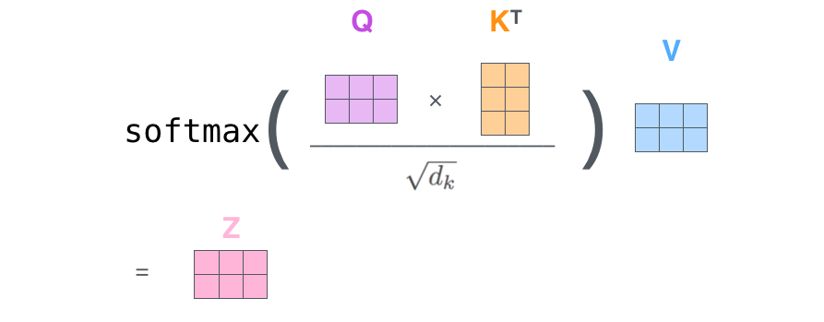
Why Informer?
Transformer cell:
High 1. Space-2. Time complexity

Slide 5
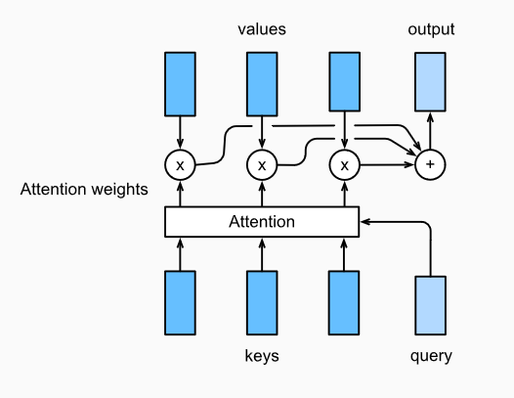
Why Informer?
Attention mechanism:
3. Predicts one output at a time

Slide 6
Why Informer?
Informer:
1. Query sparcity Measurement lowers Space complexity
2. ProbSparse lowers Time Complexity
3. Predicts sequence in one batch (Generative Style Decoder)

Slide 7
PART 02
3 Main improvments

Slide 8
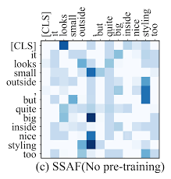
3 Main Improvements
1
Attention values:
long-tail distributed
Therefore:
Prune needed.

Slide 9
3 Main Improvements
1
Attention values:
It upweights the most important values, only when the exp(q_i k_j^T) is away from constant
i.e. KLD to the constant distribution is large

Slide 10
3 Main Improvements
1
Therefore: thresholding the queries, so that queries inducing top-u KLD-values are kept (rests set to zero)
u =c ln L_Q (not proven!)

Slide 11
3 Main Improvements
2
Attention values:

Slide 12
3 Main Improvements
2
Attention values:
For keys:
By long tail distribution of the attention value
Randomly select U= L_Q ln L_k keys suffices

Slide 13
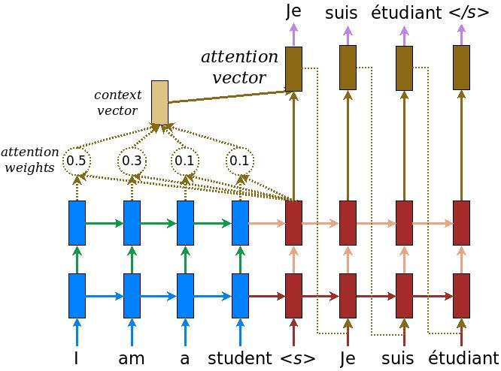
3 Main Improvements
3
Inference:
Vanilla attentive RNN:
auto-regressive, cummulates error

Slide 14
3 Main Improvements
3
Generative Style Decoder:
Feature map from the encoder
Informer:
Predicts the target in one batch
ProbSparse Attention matrix
0 0 0 0

Slide 15
PART 03
Miscellaneous

Slide 16


Miscellaneous
1. Max-mean
instead of
ln sum
Vanilla KLD (omitting constants):
Informer: max - mean
the order holds (proven in appendix)

Slide 17
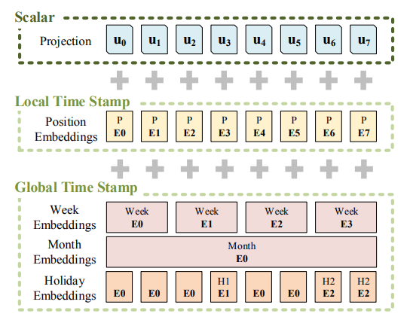
Miscellaneous
2. Global and
local
timestamps

Slide 18
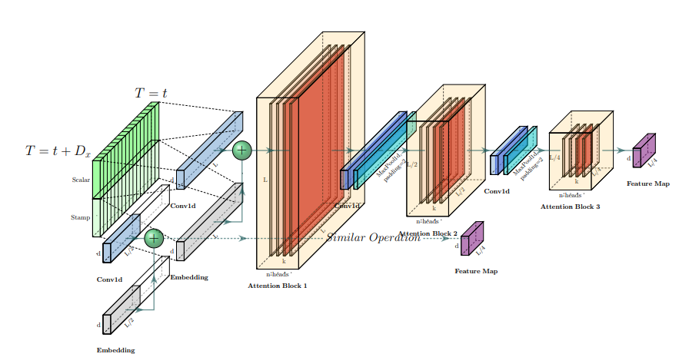
Miscellaneous
3. Half-slice
replicas

Slide 19
PART 04
Experiments

Slide 20
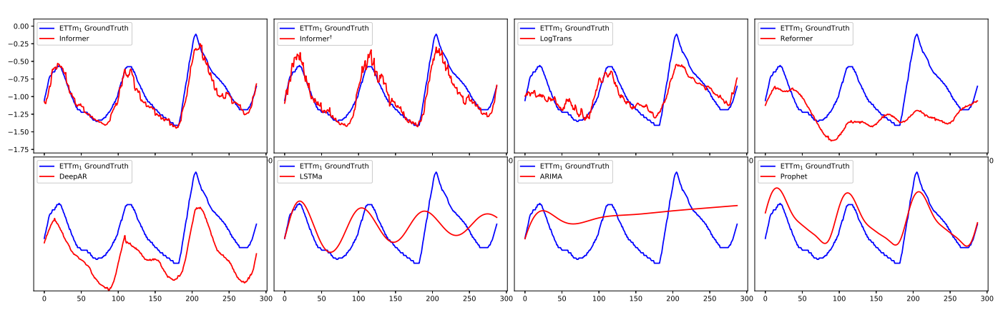
ETT
Electricity Transformer Temperature

Slide 21
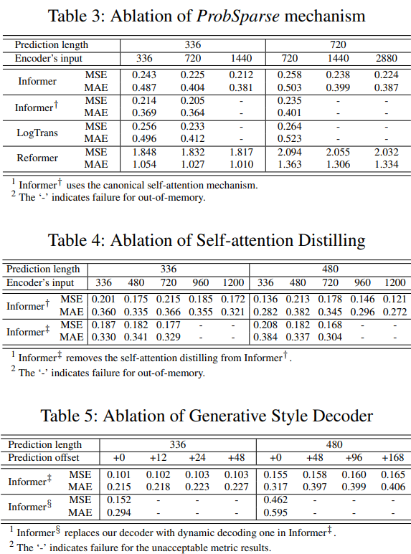
Ablation Study

Slide 22
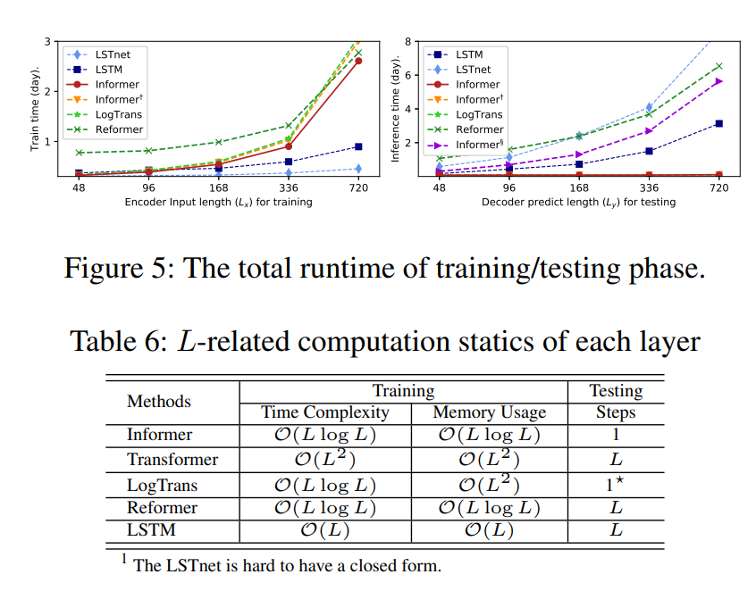
Time

Slide 23
PART 05
Unclear

Slide 24
Unclear
The precondition of using max-mean instead of KLD:
1. assume all keys are IID following some Gaussian distributions (basic assumption)
2. It holds only for queries resulting in top-u KLDs (conition).
3. The attention values are long-tail distributed (verified, but on one dataset only).
4. The variance of query-key dot products also decreases along with the KLD (Alert, comes from no where).

Slide 25
Unclear
Need to know the length of the prediction, but one can use spaceholders.

Slide 26
THANKS FOR YOUR
ATTENTION

